Slide 2
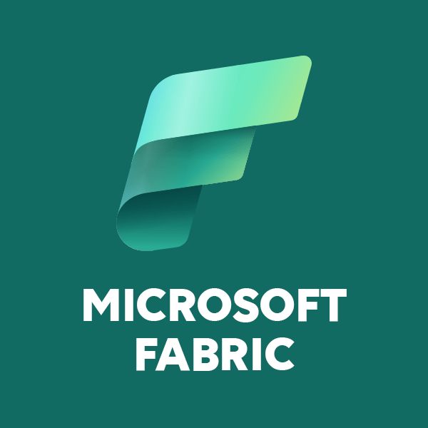
Microsoft Fabric
Simplifying Data and Analytics with a Unified Platform
Present by,
NIVETHA K

Slide 3
Microsoft Fabric
Announced in May 2003 to simplify analytics and data management.
Unified analytics Platform.
Simplify and integrate data and analytics -> Reduce workloads
Combines ( Different tools and Services)
Saves time, Reduce Complexity, Better decisions

Slide 4
Lifecycle Management
Business can
Collect data
Store data
Process data
Analyze data
Creating Reports

Slide 5
Traditional Challenges
Fragmented tools – Difficult to access data
Complicated Workflows
Data silos – Data’s in Different places (Teams can’t be easily accessed)
Complexity – Managing Multiple tools
Scalability Issues – Traditional analytics get struggled to handle data

Slide 6
Fabric’s Solution
Combined tools like Power BI, Data Factory, Lakehouse
Introduced AI and Machine learning Capabilities
Simplifying data Operations and improving Decision making

Slide 7
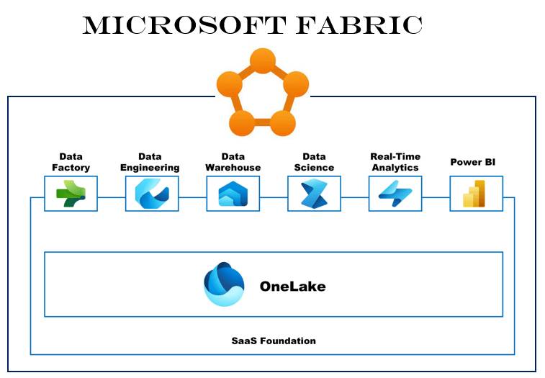
Microsoft Fabric Ecosystem Components

Slide 8
Data Factory – Data Ingestion (Getting From Multiple Resources) and Data Integration(Unified view of data)
Data Engineering – Convert raw data into usable information (ETL)
Data Warehouse - Centralized location (Structured data Storage)
- Fast Querying and Analytics
Data Science - Building and Deploying the Machine learning Models
Real-Time Analytics - Process data as it Happens, Without delay
- Quick decisions using Live data
Power BI - Business intelligence tool
- Interactive Dashboards and reports

Slide 9
One Lake – Store data (Structure and Unstructured data)
SaaS Foundation – Delivering Software over the Internet
- tools and services (No need installation)

Slide 10
Data Activator
Real-time Automation (Monitoring data and triggering actions)
Example –
Fraud Deduction in banking
The bank can prevent fraudulent activities and protect its customers proactively.
Example –
IoT Device Monitoring in Manufacturing
Prevents costly downtime and ensures the safety of operations.

Slide 11
Security and Governance in Fabric
Data safe and ensure it follows all the necessary Rules and Regulations
->Role Based Access Control (RBAC) – Based on the role – Analyst, Data scientist, Big data Engineer..etc
->Monitoring and Auditing – Who access data, What changes made, When they occurred

Slide 12
AI and ML Integration
Integrates AI and machine learning tools
Build and Run the ML models directly within Fabric
Pre-Build AI models For Sentiment analysis, Image Recognition or Text Classification
Custom models (Using Python Libraries, then deploy within Fabric)

Slide 13
Data Preparation
Centralized Data Storage – Data Can be access from Fabric’s One Lake
Built-in Tools – Cleaning, Transforming, And Formatting raw data into usable form
Integration with ML Tools – Azure Machine learning, Auto ML

Slide 14
Collaboration in Microsoft Fabric
Collaborate tools – Microsoft Teams
Enable seamless Communication, Collaboration on data Projects
Track changes made by team members

Slide 15
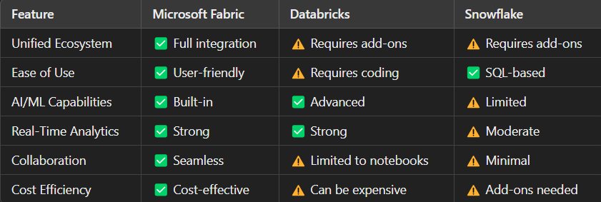
Microsoft Fabric vs Competitors

Slide 16
Application
Healthcare – Combine (Electronic Health records(EHRs)
- Creating Dashboards (Track patient Recovery)
Retail – Analyze Customer data
- Recommend Products
Finance - Monitor Transactions
- Generate Reports

Slide 17
Future Enhancement
Chat-based Data analysis
Pre-Built AI Tools
More data Integration (Full Multi-cloud integration)
“Potential Improvements or Extensions of the Existing Features”

Slide 18
Microsoft Fabric Resources
Get started with Microsoft Fabric
Data Engineering with Microsoft Fabric
Analytics and AI in Fabric

Slide 19
Steps to Create Microsoft Fabric Account
Step 1 : Outlook Account
(https://signup-live.com)
Step 2 : Join Microsoft 365 Developer Program
(https://aka.ms/GetM365Developer)
Step 3 : Go to Fabric page start free trial

